Slide 1

Phase-XII Choose Research Area and Datasets Training / Inference in noisy environments and incomplete data
Guided by: Dr. Sabah Mohammed
Mohan Prasad Kutala
mkutala@lakeheadu.ca

Slide 2
Research Area
X-Rays to know the severity of the disease and level of infection inside the body
we can use X-rays to analyse the health of a patient’s lungs
public can alert and have a chance to consult or ask doctor for remedy for the damage
X-ray images as doctors frequently use X-rays and CT scans to diagnose pneumonia, lung inflammation, abscesses, and enlarged lymph nodes
A drawback is that X-ray analysis requires a radiology expert and takes significant time which is precious when people are sick around the world
So, developing an automated analysis system is required to save medical professionals valuable time.

Slide 3
COVID-19 images
A team of researchers from Qatar University, Qatar and the University Of Dhaka, Bangladesh along with their collaborators from Pakistan and Malaysia in collaboration with medical doctors have created a database of chest X-ray images for COVID-19 positive cases along with Normal and Viral Pneumonia images.
COVID-19 data:
COVID data are collected from different publicly accessible dataset, online sources and published papers.
-2473 CXR images are collected from padchest dataset.
-183 CXR images from a Germany medical school.
-559 CXR image from SIRM, Github, Kaggle
-400 CXR images from another Github source.
Normal images:
10192 Normal data are collected from from three different dataset.
-8851 RSNA [8]
-1341 Kaggle [9]
Viral Pneumonia images:
1345 Viral Pneumonia data are collected from the Chest X-Ray Images (pneumonia) database.
https://www.kaggle.com/paultimothymooney/chest-xray-pneumonia

Slide 4
Pneumonia images
A dataset of 2373 Chest X-ray (CXR) images from Stony Brook Medicine. Each CXR has been scored by two radiologists. There are multiple CXRs per patient and temporal information is included.
Authors list: Joseph Paul Cohen from Stanford University; Beiyi Shen; Almas Abbasi; Mahsa Hoshmand-Kochi; Samantha Glass; Haifang Li; Matthew P Lungren; Akshay Chaudhari; Tim Q Duong
RALO Dataset:
https://zenodo.org/record/4634000#.YX2YGp7MJPY
Covid-19 chest x-ray images along with RALO dataset

Slide 5
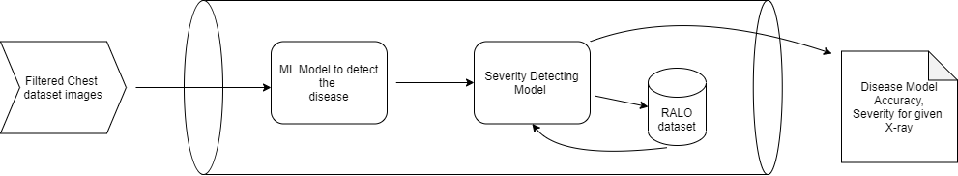
Pneumonia images
A dataset of 3,875 images
→ For training of pneumonia with 1341 normal chest x-rays.
Testing with 390 images and 234 normal images for it.
They have used 9 pneumonia images and 8 normal images for validation of model.
https://www.kaggle.com/tawsifurrahman/covid19-radiography-database?select=COVID-19_Radiography_Dataset

Slide 6
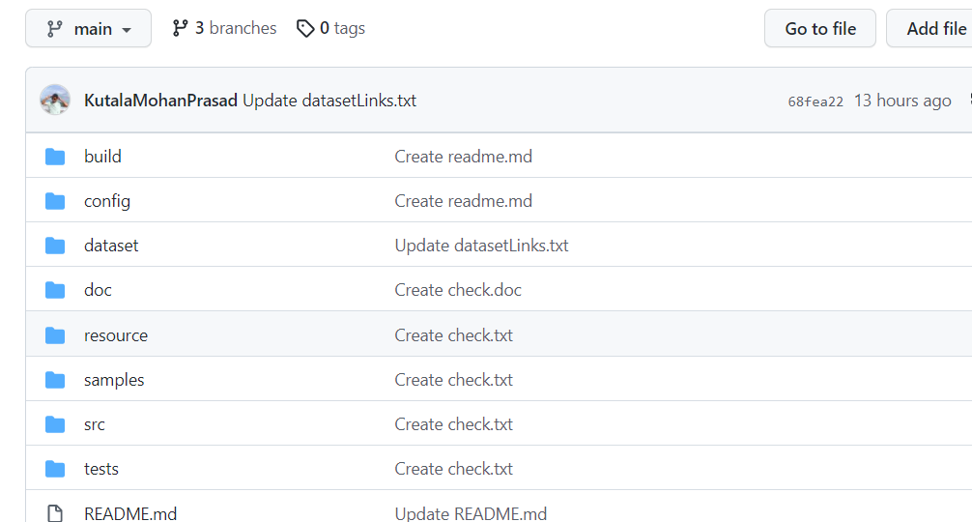
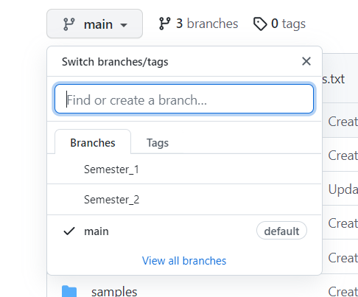
GitHub
https://github.com/KutalaMohanPrasad/Mohan_COMP5800YDG_Research_Project

Slide 7


